Slide 1
Directly reconstructing principal components of 3D protein structure density map from 2D cryo-EM projection images by 2SDR method
陳慶豐
指導老師: 杜憶萍

Slide 2
Outline
Fourier slice theorem for 3D covariance functions
EM-PCA for computing 3D structure
Math part
Code part
Experiment on heterogeneous Ribosome protein
EM-MPCA for computing 3D structure
Math part
Code version 1: Using pytorch autograd.
How pytorch compute gradient automatically ?
How to port “any” function into pytorch framework?
Code version 2: Not using auto grad. (working on)

Slide 3
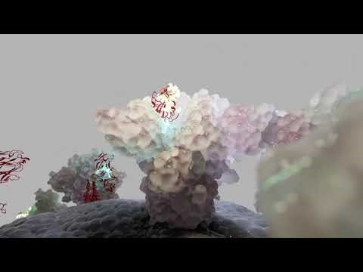
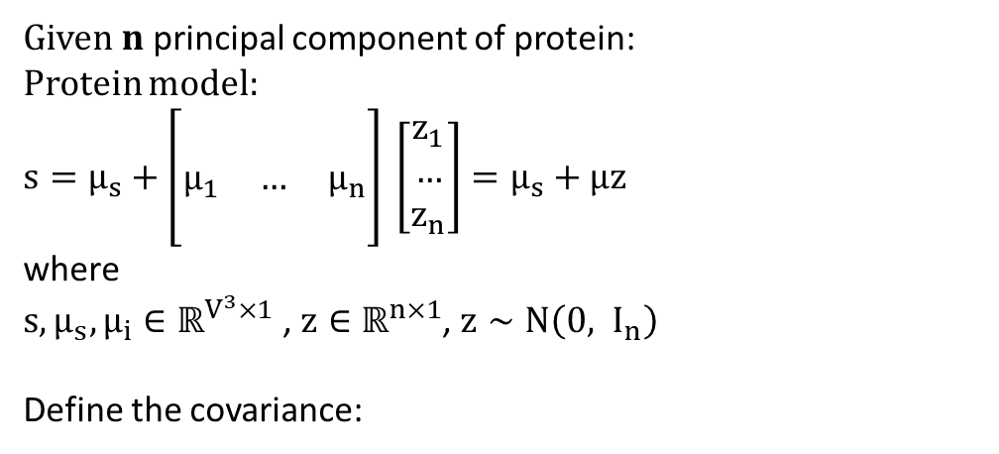
Heterogeneous protein model
Given $n$ principal component of protein:
Protein model:
$\begin{aligned}s=μ_{s}+\left[\begin{matrix} & & \\ μ_{1} & … & μ_{n} \\ & & \end{matrix}\right] \left[\begin{matrix}z_{1} \\ … \\ z_{n}\end{matrix}\right]=μ_{s}+μz\end{aligned}$
where
$s,μ_{s},μ_{i}∈ℝ^{V^{3}×1}$ , $z∈ℝ^{n×1}$, $z∼N\left(0, I_{n}\right)$
Define the covariance:
$Σ_{s}\left(u,v\right)=𝔼\left[\left(s\left(u\right)−μ_{s}\left(u\right)\right)\left(s\left(ν\right)−μ_{s}\left(ν\right)\right)\right]$

Slide 4
Fourier slice theorem for 3D covariance functions

Slide 5
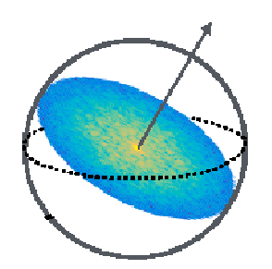
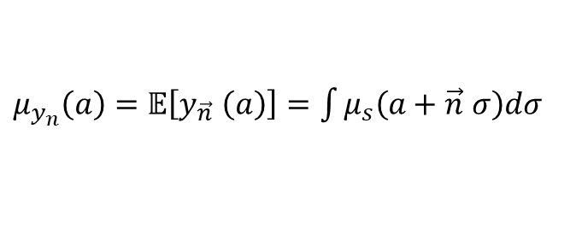




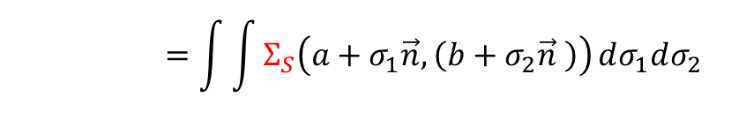
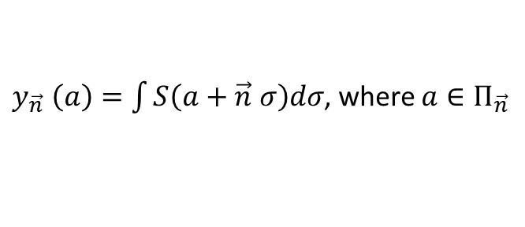
Fourier slice theorem for 3D covariance functions
$$\vec{n}$$
Define:
$Π_{\vec{n} }$ be the plane perpendicular to $\vec{n}$
$y_{\vec{n} }\left(a\right)=\int{S\left(a+\vec{n} σ\right)dσ}$, where $a∈Π_{\vec{n}}$
Since $S$ is a random variable, $y_{\vec{n} }\left(a\right)$ is R.V. too.
a
$μ_{y_{n}}\left(a\right)=𝔼\left[y_{\vec{n} }\left(a\right)\right]=\int{μ_{s}\left(a+\vec{n} σ\right)dσ}$
$Σ_{y_{n}}\left(a, b\right)=𝔼\left[\left(y_{\vec{n} }\left(a\right)−μ_{y_{n}}\left(a\right)\right)\left(y_{\vec{n} }\left(b\right)−μ_{y_{n}}\left(b\right)\right)\right]$
$$Σ_{y_{n}}\left(a, b\right)=\int{\int{Σ_{S}\left(a+σ_{1}\vec{n},\left(b+σ_{2}\vec{n} \right)\right)}dσ_{1}dσ_{2}}$$
$$Π_{\vec{n} }$$

Slide 6
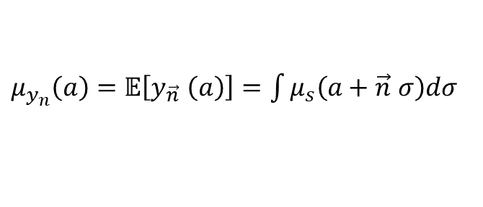
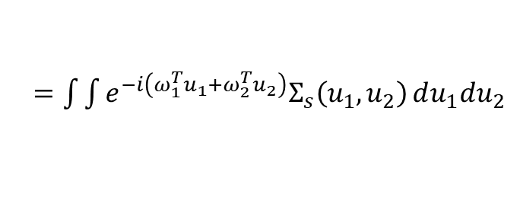



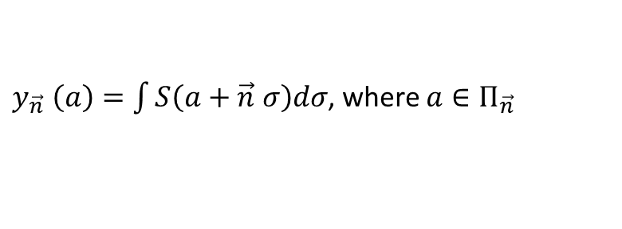




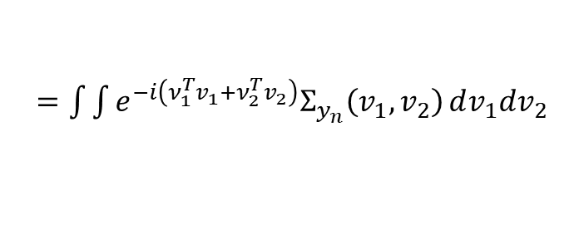
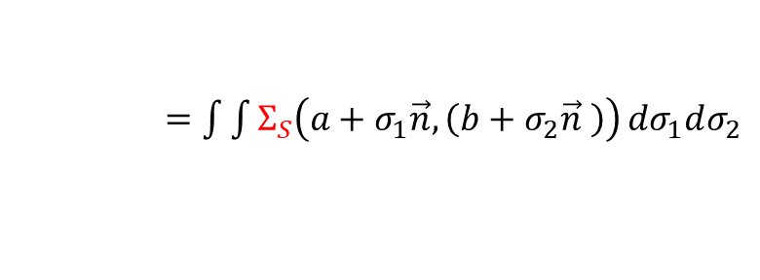


Fourier slice theorem for 3D covariance functions
$$\vec{n}$$
Define:
Define Fourier transform of covariance
$Π_{\vec{n} }$ be the plane perpendicular to $\vec{n}$
functions:
$y_{\vec{n} }\left(a\right)=\int{S\left(a+\vec{n} σ\right)dσ}$, where $a∈Π_{\vec{n}}$
$F_{s}\left(ω_{1},ω_{2}\right)$
a
$F_{s}\left(ω_{1},ω_{2}\right)$
Since $S$ is a random variable, $y_{\vec{n} }\left(a\right)$ is R.V. too.
$=\int{\int{e^{−i\left(ω_{1}^{T}u_{1}+ω_{2}^{T}u_{2}\right)}Σ_{s}\left(u_{1},u_{2}\right)}du_{1}du_{2}}$
$μ_{y_{n}}\left(a\right)=𝔼\left[y_{\vec{n} }\left(a\right)\right]=\int{μ_{s}\left(a+\vec{n} σ\right)dσ}$
$\tilde{F_{y_{n}}}\left(ν_{1},ν_{2}\right)$
$$Π_{\vec{n} }$$
$Σ_{y_{n}}\left(a, b\right)=𝔼\left[\left(y_{\vec{n} }\left(a\right)−μ_{y_{n}}\left(a\right)\right)\left(y_{\vec{n} }\left(b\right)−μ_{y_{n}}\left(b\right)\right)\right]$
$=\int{\int{e^{−i\left(ν_{1}^{T}v_{1}+ν_{2}^{T}v_{2}\right)}Σ_{y_{n}}\left(v_{1},v_{2}\right)}dv_{1}dv_{2}}$
$Σ_{y_{n}}\left(a, b\right)=\int{\int{Σ_{S}\left(a+σ_{1}\vec{n},\left(b+σ_{2}\vec{n} \right)\right)}dσ_{1}dσ_{2}}$
Where $ω_{1},ω_{2}∈ℝ^{3}$, $ν_{1},ν_{2}∈ℝ^{2}$
Then $F_{s}\left(ω_{1},ω_{2}\right)=\tilde{F_{y_{n}}}\left(ω_{1},ω_{2}\right)$
Then we get $\tilde{F_{y_{n}}}\left(ω_{1},ω_{2}\right)$ by data => $F_{s}\left(ω_{1},ω_{2}\right)$ => $Σ_{s}\left(u_{1},u_{2}\right)$

Slide 7

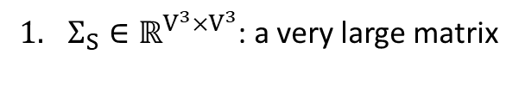

Opposite of this method
$$\vec{n}$$
$Σ_{S}∈ℝ^{V^{3}×V^{3}}$: a very large matrix
We can only get finite angles
a
Some angle have little data to compute good covariance
Noise isn’t modeled in this method
The amount of noise might vary in each image.
$$Π_{\vec{n} }$$

Slide 8
EM-PCA for computing 3D structure

Slide 9
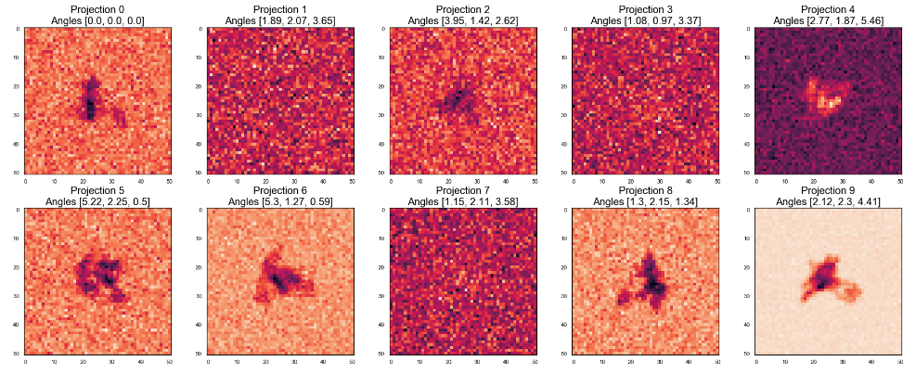
Image model
For $N$ images,
$$I_{j}=A_{J}s+ϵ_{j}=A_{J}\left(μ_{s}+μz_{j} \right)+ϵ_{j}, j=1…N$$
Where $ϵ∼N\left(0, σ_{j}I\right)$

Slide 10
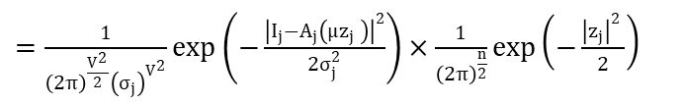
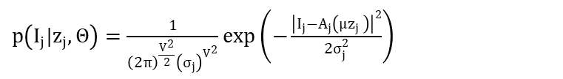

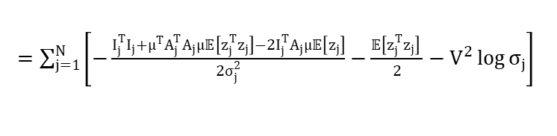
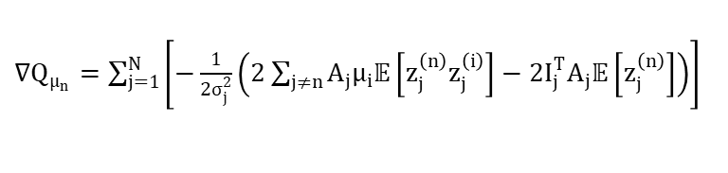


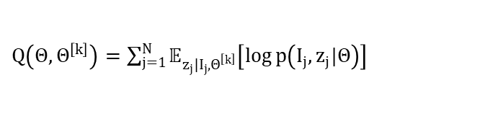

PCA model
$p\left(I_{j}|z_{j},Θ\right)=\frac{1}{{\left(2π\right)}^{\frac{V^{2}}{2}}{\left(σ_{j}\right)}^{V^{2}}}\exp\left(−\frac{{\left|I_{j}−A_{j}\left(μz_{j} \right)\right|}^{2}}{2σ_{j}^{2}}\right)$
Expectation:
$𝔼\left[z\right]=\frac{1}{σ^{2}}{\left(\frac{1}{σ^{2}}μ^{T}A_{j}^{T}A_{j}z_{j}+I\right)}^{−1}μ^{T}A_{j}^{T}I_{j}$
$$p\left(I_{j},z_{j}|Θ\right)=p\left(I_{j}|z_{j},Θ\right)p\left(z_{j}|Θ\right)=p\left(I_{j}|z_{j},Θ\right)p\left(z_{j}\right)$$
$𝔼\left[z_{i}z_{j}\right]={\left(\frac{1}{σ^{2}}μ^{T}A_{j}^{T}A_{j}μ_{j}+I\right)}^{−1}−𝔼\left[z_{i}\right]𝔼{\left[z_{j}\right]}^{T}$
$=\frac{1}{{\left(2π\right)}^{\frac{V^{2}}{2}}{\left(σ_{j}\right)}^{V^{2}}}\exp\left(−\frac{{\left|I_{j}−A_{j}\left(μz_{j} \right)\right|}^{2}}{2σ_{j}^{2}}\right)×\frac{1}{{\left(2π\right)}^{\frac{n}{2}}}\exp\left(−\frac{{\left|z_{j}\right|}^{2} }{2}\right)$
$Q\left(Θ,Θ^{\left[k\right]}\right)=\sum_{j=1}^{N}{𝔼_{z_{j}|I_{j},Θ^{\left[k\right]}}\left[\log{p\left(I_{j},z_{j}|Θ\right)}\right]}$
Maximization:
$=\sum_{j=1}^{N}{𝔼_{z_{j}|I_{j},Θ^{\left[k\right]}}\left[−\frac{{\left|I_{j}−A_{j}\left(μz_{j} \right)\right|}^{2}}{2σ_{j}^{2}}−\frac{{\left|z_{j}\right|}^{2} }{2}−V^{2}\log{σ_{j}}\right]}$
$∇Q_{μ_{n}}=\sum_{j=1}^{N}{\left[−\frac{1}{2σ_{j}^{2}}\left(2\sum_{j≠n}{A_{j}μ_{i}𝔼\left[z_{j}^{\left(n\right)}z_{j}^{\left(i\right)}\right]}−2I_{j}^{T}A_{j}𝔼\left[z_{j}^{\left(n\right)}\right]\right)\right]}$
$=\sum_{j=1}^{N}{\left[−\frac{I_{j}^{T}I_{j}+μ^{T}A_{j}^{T}A_{j}μ𝔼\left[z_{j}^{T}z_{j}\right]−2I_{j}^{T}A_{j}μ𝔼\left[z_{j}\right]}{2σ_{j}^{2}}−\frac{𝔼\left[z_{j}^{T}z_{j}\right] }{2}−V^{2}\log{σ_{j}}\right]}$
$\hat{σ_{j}}=\sqrt{\frac{1}{V^{2}}\left(I_{j}^{T}I_{j}+μ^{T}A_{j}^{T}A_{j}μ𝔼\left[z_{j}^{T}z_{j}\right]−2I_{j}^{T}A_{j}μ𝔼\left[z_{j}\right]\right)}$
Notes:
那接下來我要介紹如何使用EM algorithm來計算這個2sdr的結果。
為了要進行推導，我們在這邊先把2sdr的model以及他所使用到的notations整理在這邊。
MPCA的model

Slide 11
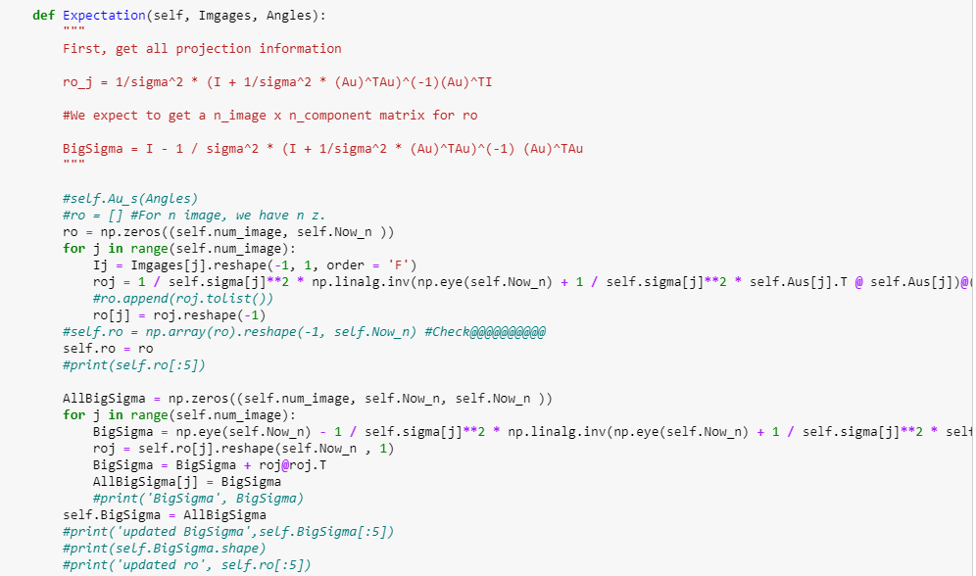
Code: Expectation

Slide 12
Data preparation
With no noise

Slide 13
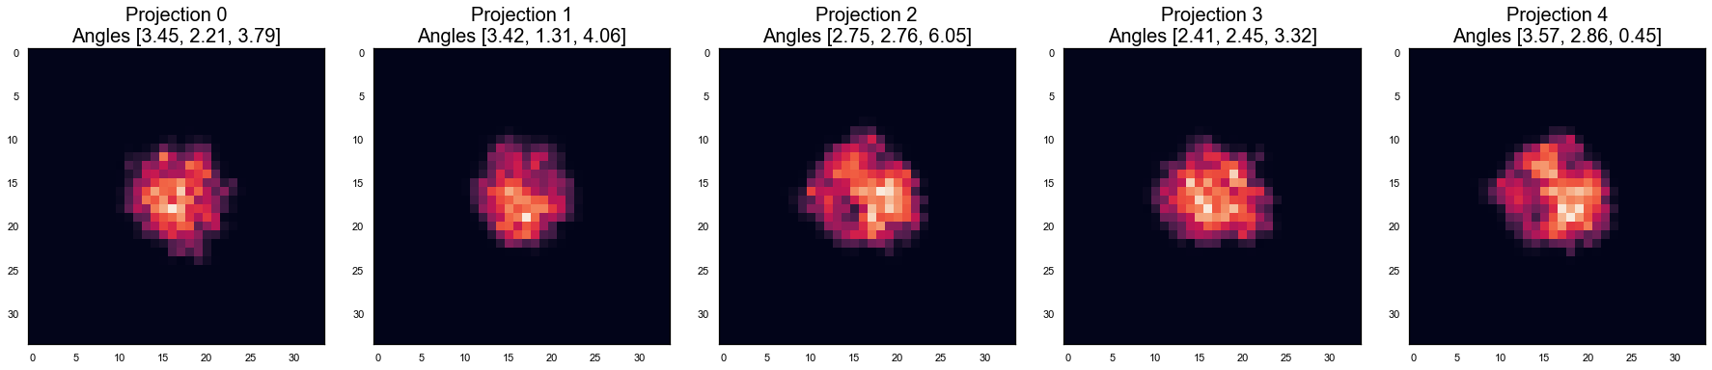
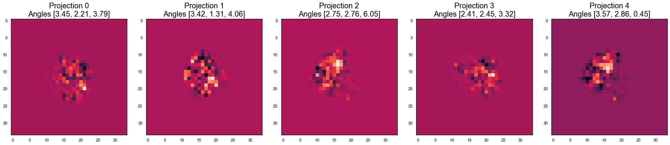
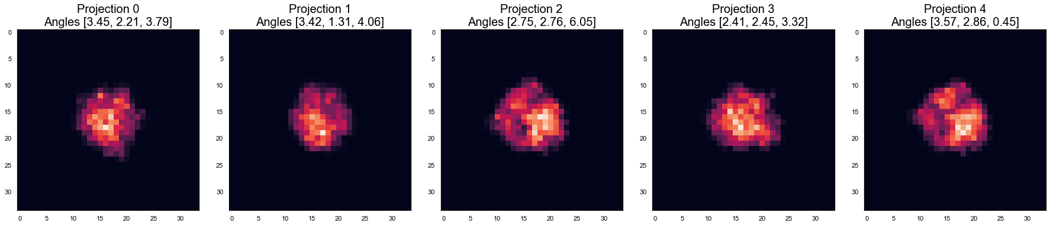
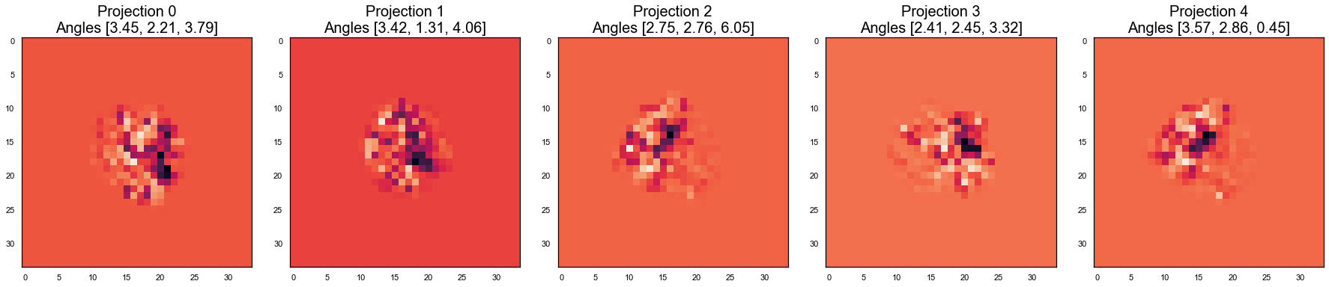
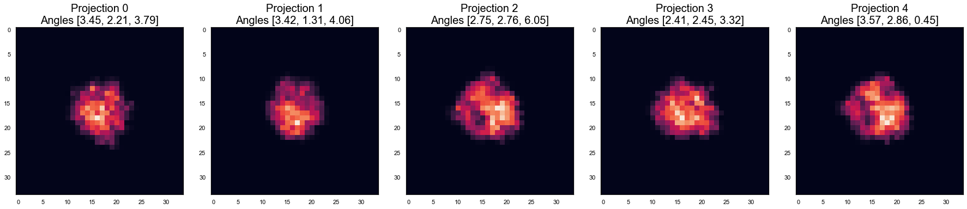
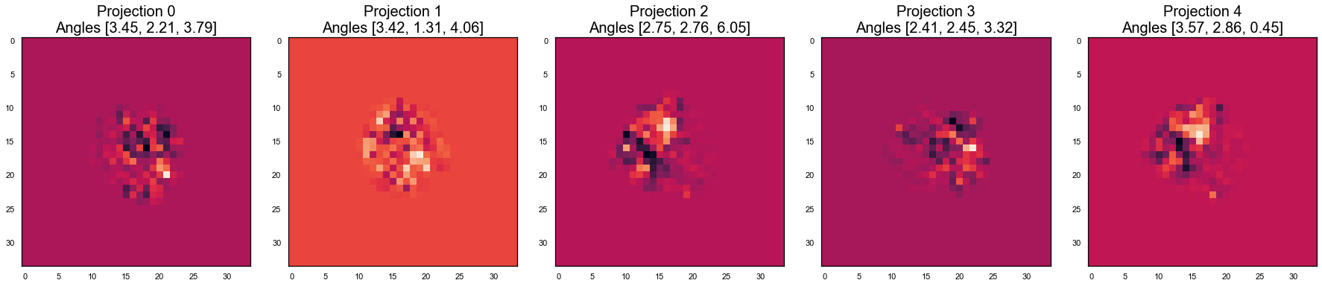
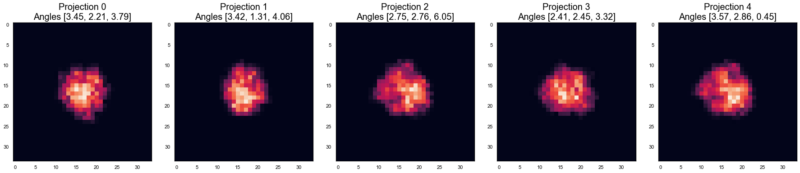
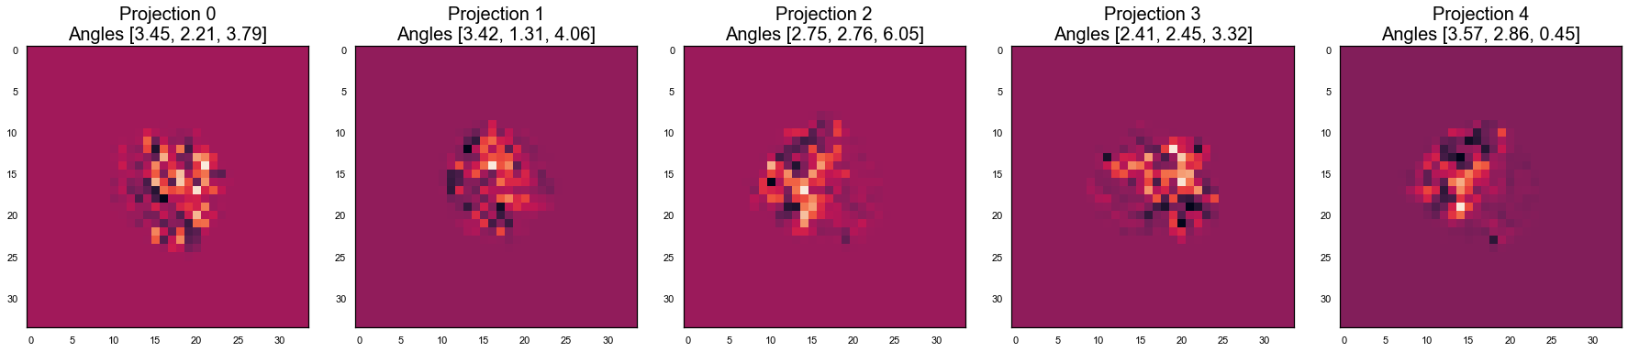
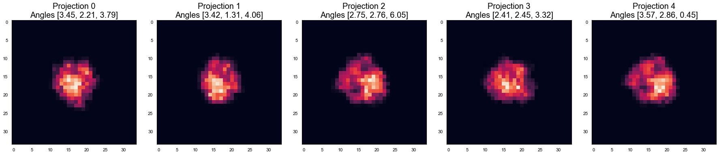
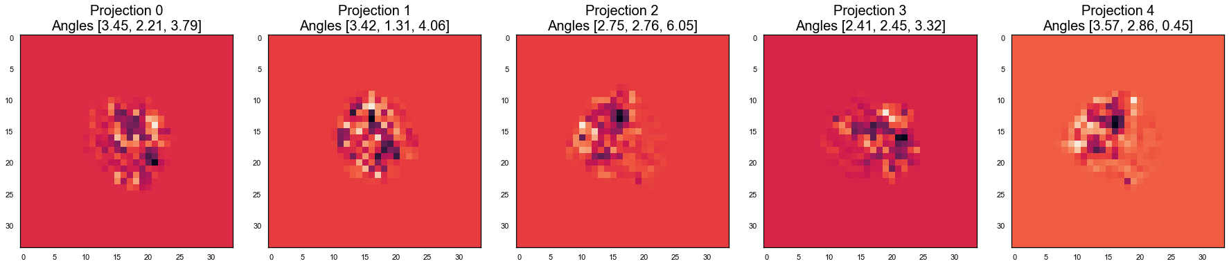
5 Ribosome proteins
Variance
12.025575
16.361185
12.834149
29.444565
28.413883

Slide 14
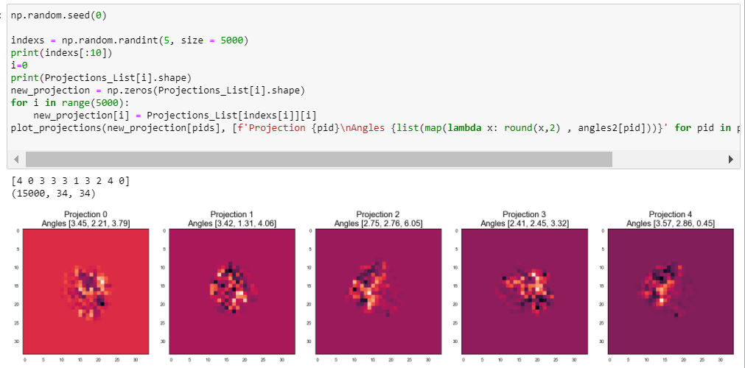
Create dataset
Generate random sequence to select which protein to choose.

Slide 15
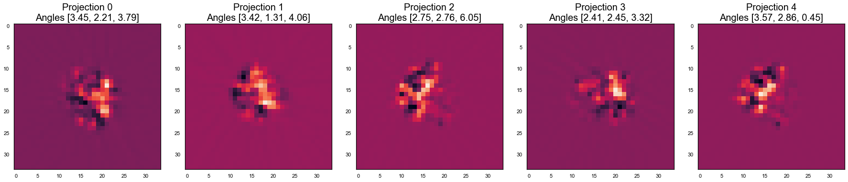
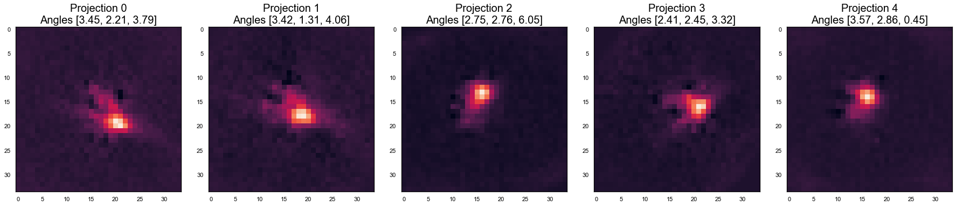
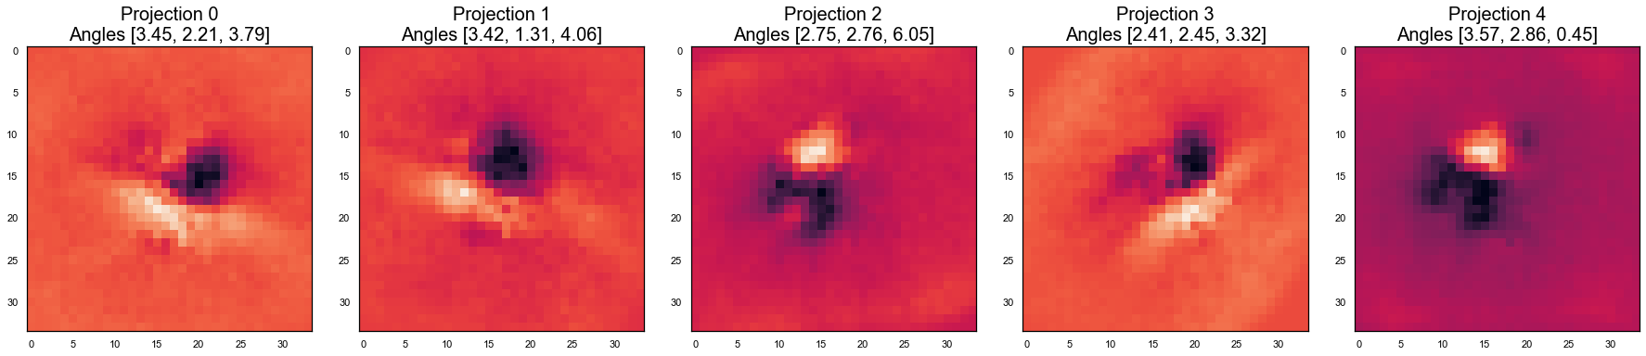
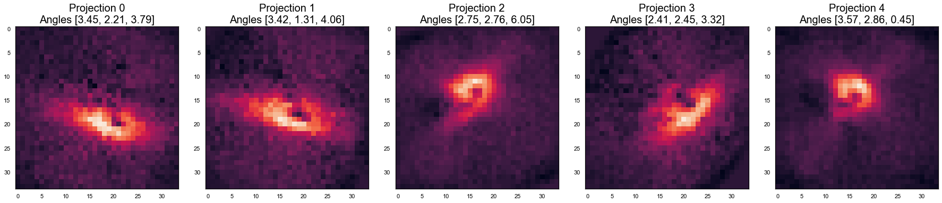
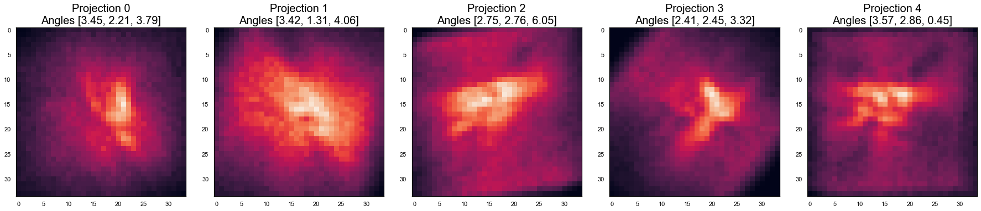
Generated orthogonal structures
Variance
29.444565
28.413883
16.361185
12.834149
12.025575

Slide 16
Find coefficient by finding expectation
給定某個照片，估計其每個結構的係數期望值:
$$𝔼\left[z|I_{j},θ^{t}\right]=\frac{1}{σ^{2}}{\left(\frac{1}{σ^{2}}μ^{T}A_{j}^{T}A_{j}z_{j}+I\right)}^{−1}μ^{T}A_{j}^{T}I_{j}=ρ$$
$$\left[\begin{matrix}c_{1} \\ c_{2} \\ c_{3} \\ c_{4} \\ c_{5}\end{matrix}\right]$$
$$\left[\begin{matrix}c_{1} \\ c_{2} \\ c_{3} \\ c_{4} \\ c_{5}\end{matrix}\right]$$
$$\left[\begin{matrix}c_{1} \\ c_{2} \\ c_{3} \\ c_{4} \\ c_{5}\end{matrix}\right]$$
$$\left[\begin{matrix}c_{1} \\ c_{2} \\ c_{3} \\ c_{4} \\ c_{5}\end{matrix}\right]$$
$$\left[\begin{matrix}c_{1} \\ c_{2} \\ c_{3} \\ c_{4} \\ c_{5}\end{matrix}\right]$$

Slide 17
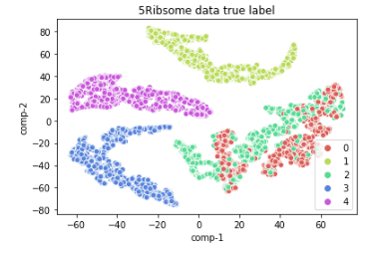
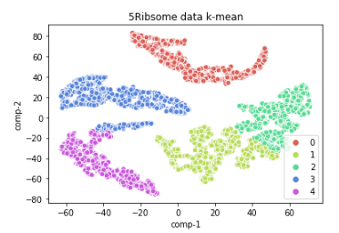
Post analysis
Set $𝔼\left[z\right]∈ℝ^{num x 5}$ as estimated coefficient of each image
Pass $𝔼\left[z\right]$ into t-SNE
Use k-mean algorithm to conduct clustering
Use V-measure to measure the result
Vmeasure = 0.7685169

Slide 18
MPCA part

Slide 19
Protein model (vector form)
Given $n$ principal component of protein:
Protein model:
$\begin{aligned}s=μ_{s}+\left[\begin{matrix} & & \\ μ_{1} & … & μ_{n} \\ & & \end{matrix}\right] \left[\begin{matrix}z_{1} \\ … \\ z_{n}\end{matrix}\right]\end{aligned}$
where
$s,μ_{s},μ_{i}∈ℝ^{V^{3}×1}$ , $z∈ℝ^{n×1}$, $z∼N\left(0, I_{n}\right)$

Slide 20
Protein model (tensor form)
Given $n$ principal component of protein:
Protein model:
$$s=μ_{s}+z×_{1}U_{1}×_{2}U_{2}×_{3}U_{3}$$
Where
$s,μ_{s}∈ℝ^{V×V×V}$ , $z∈ℝ^{P×P×P}$ , $U_{i}∈ℝ^{P_{i}×I_{i}}$
Vector, matrix form:
$$\begin{aligned}s_{\left(3\right)}=U_{3} z_{\left(3\right)} {\left(U_{1}⨂U_{2}\right)}^{T} \left(matrix form\right)\end{aligned}$$
$$\begin{aligned}\tilde{s_{\left(3\right)}}=\left(U_{1}⨂U_{2}⨂U_{3}\right)\tilde{z_{\left(3\right)}} \left(vector form\right)\end{aligned}$$

Slide 21
Image model
For $N$ images,
$$I_{j}=A_{J}s+ϵ_{j}=A_{J}\left(μ_{s}+\left(U_{1}⨂U_{2}⨂U_{3}\right)\tilde{{z_{\left(3\right)}}_{j}} \right)+ϵ_{j}, j=1…N$$
Where $ϵ∼N\left(0, σ_{j}I\right)$

Slide 22
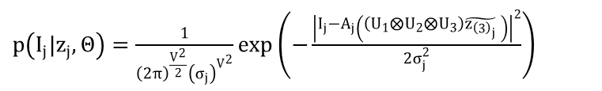
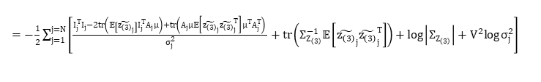
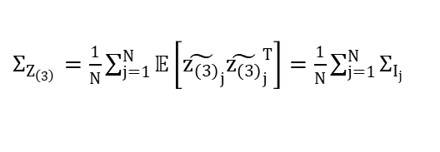
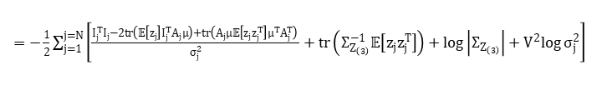
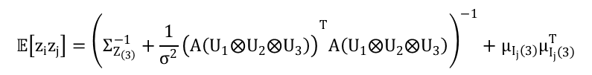
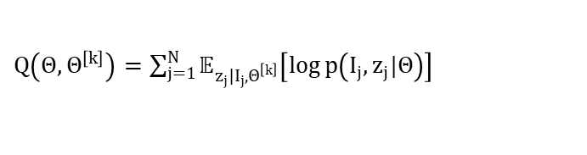

MPCA model
$p\left(I_{j}|z_{j},Θ\right)=\frac{1}{{\left(2π\right)}^{\frac{V^{2}}{2}}{\left(σ_{j}\right)}^{V^{2}}}\exp\left(−\frac{{\left|I_{j}−A_{j}\left(\left(U_{1}⨂U_{2}⨂U_{3}\right)\tilde{{z_{\left(3\right)}}_{j}} \right)\right|}^{2}}{2σ_{j}^{2}}\right)$
Expectation:
$$𝔼\left[\tilde{z_{\left(3\right)}}|I_{j}\right]=\left(Σ_{Z_{\left(3\right)}}^{−1}+{\frac{1}{σ^{2}}\left(A\left(U_{1}⨂U_{2}⨂U_{3}\right)\right)}^{T}A\left(U_{1}⨂U_{2}⨂U_{3}\right)\right){\frac{1}{σ^{2}}\left(A\left(U_{1}⨂U_{2}⨂U_{3}\right)\right)}^{T}I$$
$$p\left(I_{j},z_{j}|Θ\right)=p\left(I_{j}|z_{j},Θ\right)p\left(z_{j}|Θ\right)=p\left(I_{j}|z_{j},Θ\right)p\left(z_{j}\right)$$
$$𝔼\left[z_{i}z_{j}\right]={\left(Σ_{Z_{\left(3\right)}}^{−1}+{\frac{1}{σ^{2}}\left(A\left(U_{1}⨂U_{2}⨂U_{3}\right)\right)}^{T}A\left(U_{1}⨂U_{2}⨂U_{3}\right)\right)}^{−1}+μ_{I_{j}\left(3\right)}μ_{I_{j}\left(3\right)}^{T}$$
$=\frac{1}{{\left(2π\right)}^{\frac{V^{2}}{2}}{\left(σ_{j}\right)}^{V^{2}}}\exp\left(−\frac{{\left|I_{j}−A_{j}\left(\left(U_{1}⨂U_{2}⨂U_{3}\right)\tilde{{z_{\left(3\right)}}_{j}} \right)\right|}^{2}}{2σ_{j}^{2}}\right)×\frac{1}{{\left(2π\right)}^{\frac{P_{1}×P_{2}×P_{3}}{2}}}{\left|Σ_{Z_{\left(3\right)}}\right|}^{−\frac{1}{2}}\exp\left(−\frac{\tilde{{z_{\left(3\right)}}_{j}^{T}}Σ_{Z_{\left(3\right)}}^{−1}\tilde{{z_{\left(3\right)}}_{j}} }{2}\right)$
$Q\left(Θ,Θ^{\left[k\right]}\right)=\sum_{j=1}^{N}{𝔼_{z_{j}|I_{j},Θ^{\left[k\right]}}\left[\log{p\left(I_{j},z_{j}|Θ\right)}\right]}$
Maximization:
$=−\frac{1}{2}\sum_{j=1}^{j=N}{\left[\frac{I_{j}^{T}I_{j}−2tr\left(𝔼\left[z_{j}\right]I_{j}^{T}A_{j}μ\right)+tr\left(A_{j}μ𝔼\left[z_{j}z_{j}^{T}\right]μ^{T}A_{j}^{T}\right) }{σ_{j}^{2}}+tr\left(Σ_{Z_{\left(3\right)}}^{−1}𝔼\left[z_{j}z_{j}^{T}\right]\right)+\log\left|Σ_{Z_{\left(3\right)}}\right|+V^{2}log{σ_{j}^{2}}\right]}$
$Σ_{Z_{\left(3\right)}}=\frac{1}{N}\sum_{j=1}^{N}{𝔼\left[{\tilde{z_{\left(3\right)}}}_{j}{\tilde{z_{\left(3\right)}}}_{j}^{T}\right]}=\frac{1}{N}\sum_{j=1}^{N}{Σ_{I_{j}}}$
$=−\frac{1}{2}\sum_{j=1}^{j=N}{\left[\frac{I_{j}^{T}I_{j}−2tr\left(𝔼\left[{\tilde{z_{\left(3\right)}}}_{j}\right]I_{j}^{T}A_{j}μ\right)+tr\left(A_{j}μ𝔼\left[{\tilde{z_{\left(3\right)}}}_{j}{\tilde{z_{\left(3\right)}}}_{j}^{T}\right]μ^{T}A_{j}^{T}\right) }{σ_{j}^{2}}+tr\left(Σ_{Z_{\left(3\right)}}^{−1}𝔼\left[{\tilde{z_{\left(3\right)}}}_{j}{\tilde{z_{\left(3\right)}}}_{j}^{T}\right]\right)+\log\left|Σ_{Z_{\left(3\right)}}\right|+V^{2}log{σ_{j}^{2}}\right]}$
$σ_{j}^{2}=\frac{1}{V^{2}}\left(I_{j}^{T}I_{j}−2tr\left(𝔼\left[{\tilde{z_{\left(3\right)}}}_{j}\right]I_{j}^{T}A_{j}\left(U_{1}⨂U_{2}⨂U_{3}\right)\right)+tr\left(A_{j}\left(U_{1}⨂U_{2}⨂U_{3}\right)𝔼\left[{\tilde{z_{\left(3\right)}}}_{j}{\tilde{z_{\left(3\right)}}}_{j}^{T}\right]{\left(U_{1}⨂U_{2}⨂U_{3}\right)}^{T}A_{j}^{T}\right)\right)$
Notes:
那接下來我要介紹如何使用EM algorithm來計算這個2sdr的結果。
為了要進行推導，我們在這邊先把2sdr的model以及他所使用到的notations整理在這邊。
MPCA的model

Slide 23
Maximization
$$\frac{d\left(\sum_{j=1}^{j=N}{\left[\frac{I_{j}^{T}I_{j}−2I_{j}^{T}A_{j}\left(U_{1}⨂{U_{2}}⨂{U_{3}}\right)𝔼\left[{\tilde{z_{\left(3\right)}}}_{j}\right]+tr\left(A_{j}\left(U_{1}⨂{U_{2}}⨂{U_{3}}\right)𝔼\left[{\tilde{z_{\left(3\right)}}}_{j}{\tilde{z_{\left(3\right)}}}_{j}^{T}\right]{\left(U_{1}⨂{U_{2}}⨂{U_{3}}\right)}^{T}A_{j}^{T}\right) }{σ_{j}^{2}}\right]}\right)}{d\left(vec\left(U_{i}\right)\right)}$$
$$=\frac{\sum_{j=1}^{N}{\frac{1}{σ_{j}^{2}}d\left(−2I_{j}^{T}A_{j}\left(U_{1}⨂{U_{2}}⨂{U_{3}}\right)𝔼\left[{\tilde{z_{\left(3\right)}}}_{j}\right]+tr\left(A_{j}\left(U_{1}⨂{U_{2}}⨂{U_{3}}\right)\sum_{k=1}^{P}{c_{j,k}u_{j,k}v_{j,k}^{T}}{\left(U_{1}⨂{U_{2}}⨂{U_{3}}\right)}^{T}A_{j}^{T}\right)\right)}}{d\left(vec\left(U_{i}\right)\right)}$$
$A_{j}^{T}I_{j}=S_{j}∈ℝ^{V^{3}×1}$: Back-projection of image j
$U_{1}⨂{U_{2}}⨂{U_{3}}∈ℝ^{V^{3}×P^{3}}$
For computational purpose, 1. we perform MPCA or HOSVD on ${\left\{S_{j}\right\}}_{j=1\sim N}$ and get some principal components :
${\left\{h_{i},w_{j},l_{k}\right\}}_{ijk}$, then write $s_{j}=\sum_{xyz}{c_{j,xyz}\left(h_{j,x}⨂w_{j,y}⨂l_{j,z}\right)}$, where $h_{j,x},w_{j,y},l_{j,z}∈ℝ^{V×1}$.
2. Perform SVD on $𝔼\left[{\tilde{z_{\left(3\right)}}}_{j}{\tilde{z_{\left(3\right)}}}_{j}^{T}\right]∈ℝ^{P^{3}×P^{3}},$then write $𝔼\left[{\tilde{z_{\left(3\right)}}}_{j}{\tilde{z_{\left(3\right)}}}_{j}^{T}\right]=\sum_{k=1}^{P^{3}}{c_{j,k}u_{j,k}v_{j,k}^{T}}$

Slide 24
Maximization
$$\text{(1) }\frac{d\left(−2I_{j}^{T}A_{j}\left(U_{1}⨂U_{2}⨂U_{3}\right)𝔼\left[{\tilde{z_{\left(3\right)}}}_{j}\right]\right)}{d\left(vec\left(U_{i}\right)\right)}=\frac{d\left(−2\left(h_{j,x}^{T}U_{1}⨂{w_{j,y}^{T}U}_{2}⨂l_{j,z}^{T}U_{3}\right)𝔼\left[{\tilde{z_{\left(3\right)}}}_{j}\right] \right)}{d\left(vec\left(U_{1}\right)\right)}$$
=>
$\frac{d\left(a^{T}\left(A⨂B\right)b\right)}{dA}$, where $a∈ℝ^{1×V}, A∈ℝ^{V×P}, B∈ℝ^{1×P^{2}},b∈ℝ^{P^{3}×1}$
$$\frac{d\left(a^{T}\left(A⨂{B}\right)b\right)}{dA}=aB\left[b_{1:P^{2},}b_{P^{2}+1:P^{2}\left(1+1\right),},…,b_{{kP}^{2}+1:P^{2}\left(k+1\right),},…,b_{\left(P−1\right)P^{2}:P^{2}\left(P\right),}\right]$$
=>
$=−2\left(h_{j,x}^{}\left({w_{j,y}^{T}U}_{2}⨂{l_{j,z}^{T}}U_{3}\right)\left[{𝔼\left[{\tilde{z_{\left(3\right)}}}_{j}\right]}_{1:P^{2},}{𝔼\left[{\tilde{z_{\left(3\right)}}}_{j}\right]}_{P^{2}+1:P^{2}\left(1+1\right),},…,{𝔼\left[{\tilde{z_{\left(3\right)}}}_{j}\right]}_{\left(P−1\right)P^{2}:P^{2}\left(P\right),}\right]\right)$

Slide 25
Pytorch autograd

Slide 26

Maximization
$$\frac{d\left(\sum_{j=1}^{j=N}{\left[\frac{I_{j}^{T}I_{j}−2I_{j}^{T}A_{j}\left(U_{1}⨂{U_{2}}⨂{U_{3}}\right)𝔼\left[{\tilde{z_{\left(3\right)}}}_{j}\right]+tr\left(A_{j}\left(U_{1}⨂{U_{2}}⨂{U_{3}}\right)𝔼\left[{\tilde{z_{\left(3\right)}}}_{j}{\tilde{z_{\left(3\right)}}}_{j}^{T}\right]{\left(U_{1}⨂{U_{2}}⨂{U_{3}}\right)}^{T}A_{j}^{T}\right) }{σ_{j}^{2}}\right]}\right)}{d\left(vec\left(U_{i}\right)\right)}$$
$$= ?$$

Slide 27


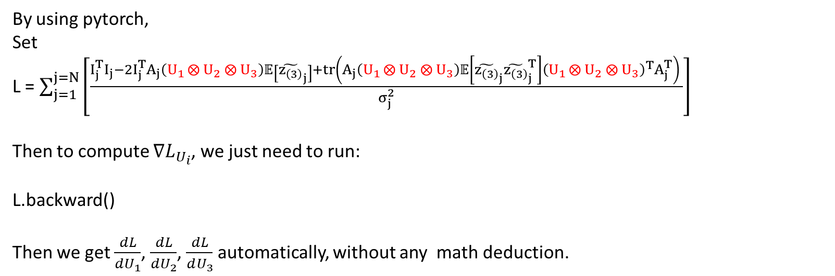
Pytorch : Automatic differentiation engine!
By using pytorch,
Set
L = $\sum_{j=1}^{j=N}{\left[\frac{I_{j}^{T}I_{j}−2I_{j}^{T}A_{j}\left(U_{1}⨂{U_{2}}⨂{U_{3}}\right)𝔼\left[{\tilde{z_{\left(3\right)}}}_{j}\right]+tr\left(A_{j}\left(U_{1}⨂{U_{2}}⨂{U_{3}}\right)𝔼\left[{\tilde{z_{\left(3\right)}}}_{j}{\tilde{z_{\left(3\right)}}}_{j}^{T}\right]{\left(U_{1}⨂{U_{2}}⨂{U_{3}}\right)}^{T}A_{j}^{T}\right) }{σ_{j}^{2}}\right]}$
Then to compute ${∇L}_{U_{i}}$, we just need to run:
L.backward()
Then we get $\frac{dL}{dU_{1}}$, $\frac{dL}{dU_{2}}$, $\frac{dL}{dU_{3}}$ automatically, without any math deduction.

Slide 28
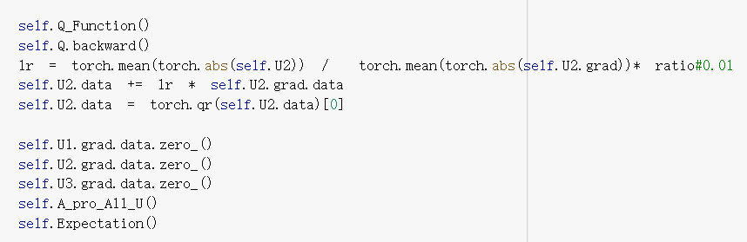
Code example

Slide 29
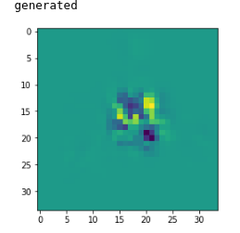
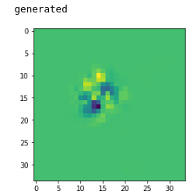
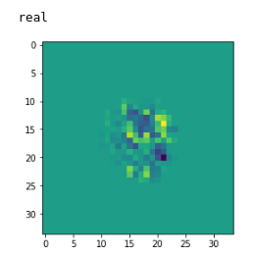
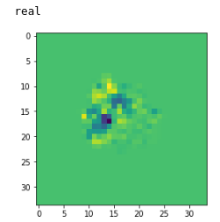
Some exp result

Slide 30

Protein model (tensor form) Version1 problem
P can only be $≤$ 5
Given $n$ principal component of protein:
Protein model:
$$s=μ_{s}+z×_{1}U_{1}×_{2}U_{2}×_{3}U_{3}$$
Where
$s,μ_{s}∈ℝ^{V×V×V}$ , $z∈ℝ^{P×P×P}$ , $U_{i}∈ℝ^{P_{i}×I_{i}}$
Vector, matrix form:
$$\begin{aligned}s_{\left(3\right)}=U_{3} z_{\left(3\right)} {\left(U_{1}⨂U_{2}\right)}^{T} \left(matrix form\right)\end{aligned}$$
$$\begin{aligned}\tilde{s_{\left(3\right)}}=\left(U_{1}⨂U_{2}⨂U_{3}\right)\tilde{z_{\left(3\right)}} \left(vector form\right)\end{aligned}$$

Slide 31
Maximization
$$\frac{d\left(\sum_{j=1}^{j=N}{\left[\frac{I_{j}^{T}I_{j}−2I_{j}^{T}A_{j}\left(U_{1}⨂{U_{2}}⨂{U_{3}}\right)𝔼\left[{\tilde{z_{\left(3\right)}}}_{j}\right]+tr\left(A_{j}\left(U_{1}⨂{U_{2}}⨂{U_{3}}\right)𝔼\left[{\tilde{z_{\left(3\right)}}}_{j}{\tilde{z_{\left(3\right)}}}_{j}^{T}\right]{\left(U_{1}⨂{U_{2}}⨂{U_{3}}\right)}^{T}A_{j}^{T}\right) }{σ_{j}^{2}}\right]}\right)}{d\left(vec\left(U_{i}\right)\right)}$$
$$=\frac{\sum_{j=1}^{N}{\frac{1}{σ_{j}^{2}}d\left(−2I_{j}^{T}A_{j}\left(U_{1}⨂{U_{2}}⨂{U_{3}}\right)𝔼\left[{\tilde{z_{\left(3\right)}}}_{j}\right]+tr\left(A_{j}\left(U_{1}⨂{U_{2}}⨂{U_{3}}\right)\sum_{k=1}^{P}{c_{j,k}u_{j,k}v_{j,k}^{T}}{\left(U_{1}⨂{U_{2}}⨂{U_{3}}\right)}^{T}A_{j}^{T}\right)\right)}}{d\left(vec\left(U_{i}\right)\right)}$$
$A_{j}^{T}I_{j}=S_{j}∈ℝ^{V^{3}×1}$: Back-projection of image j
$U_{1}⨂{U_{2}}⨂{U_{3}}∈ℝ^{V^{3}×P^{3}}$
For computational purpose, 1. we perform MPCA or HOSVD on ${\left\{S_{j}\right\}}_{j=1\sim N}$ and get some principal components :
${\left\{h_{i},w_{j},l_{k}\right\}}_{ijk}$, then write $s_{j}=\sum_{xyz}{c_{j,xyz}\left(h_{j,x}⨂w_{j,y}⨂l_{j,z}\right)}$, where $h_{j,x},w_{j,y},l_{j,z}∈ℝ^{V×1}$.
2. Perform SVD on $𝔼\left[{\tilde{z_{\left(3\right)}}}_{j}{\tilde{z_{\left(3\right)}}}_{j}^{T}\right]∈ℝ^{P^{3}×P^{3}},$then write $𝔼\left[{\tilde{z_{\left(3\right)}}}_{j}{\tilde{z_{\left(3\right)}}}_{j}^{T}\right]=\sum_{k=1}^{P^{3}}{c_{j,k}u_{j,k}v_{j,k}^{T}}$

Slide 32
Maximization
$$\text{(1) }\frac{d\left(−2I_{j}^{T}A_{j}\left(U_{1}⨂U_{2}⨂U_{3}\right)𝔼\left[{\tilde{z_{\left(3\right)}}}_{j}\right]\right)}{d\left(vec\left(U_{i}\right)\right)}=\frac{d\left(−2\left(h_{j,x}^{T}U_{1}⨂{w_{j,y}^{T}U}_{2}⨂l_{j,z}^{T}U_{3}\right)𝔼\left[{\tilde{z_{\left(3\right)}}}_{j}\right] \right)}{d\left(vec\left(U_{1}\right)\right)}$$
=>
$\frac{d\left(a^{T}\left(A⨂B\right)b\right)}{dA}$, where $a∈ℝ^{1×V}, A∈ℝ^{V×P}, B∈ℝ^{1×P^{2}},b∈ℝ^{P^{3}×1}$
$$\frac{d\left(a^{T}\left(A⨂{B}\right)b\right)}{dA}=aB\left[b_{1:P^{2},}b_{P^{2}+1:P^{2}\left(1+1\right),},…,b_{{kP}^{2}+1:P^{2}\left(k+1\right),},…,b_{\left(P−1\right)P^{2}:P^{2}\left(P\right),}\right]$$
=>
$=−2\left(h_{j,x}^{}\left({w_{j,y}^{T}U}_{2}⨂{l_{j,z}^{T}}U_{3}\right)\left[{𝔼\left[{\tilde{z_{\left(3\right)}}}_{j}\right]}_{1:P^{2},}{𝔼\left[{\tilde{z_{\left(3\right)}}}_{j}\right]}_{P^{2}+1:P^{2}\left(1+1\right),},…,{𝔼\left[{\tilde{z_{\left(3\right)}}}_{j}\right]}_{\left(P−1\right)P^{2}:P^{2}\left(P\right),}\right]\right)$

